Slide 1
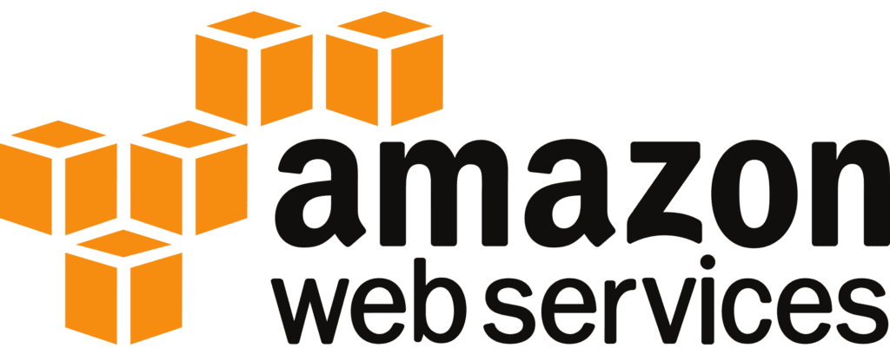

MULTI FACTOR AUTHENTICATION

Slide 2


AGENDA
What is AWS MFA?
Types
Benefits
Use Cases
Challenges
Conclusion

Slide 3
What is MFA?
Multi-Factor Authentication
Definition:
Multi-Factor Authentication (MFA) is a security mechanism that requires users to provide two or more verification factors to access an account or system.
Purpose:
MFA enhances security by ensuring that a user must authenticate their identity using multiple independent credentials, significantly reducing the risk of unauthorized access.

Slide 4

“TYPES OF MFA”

Slide 5
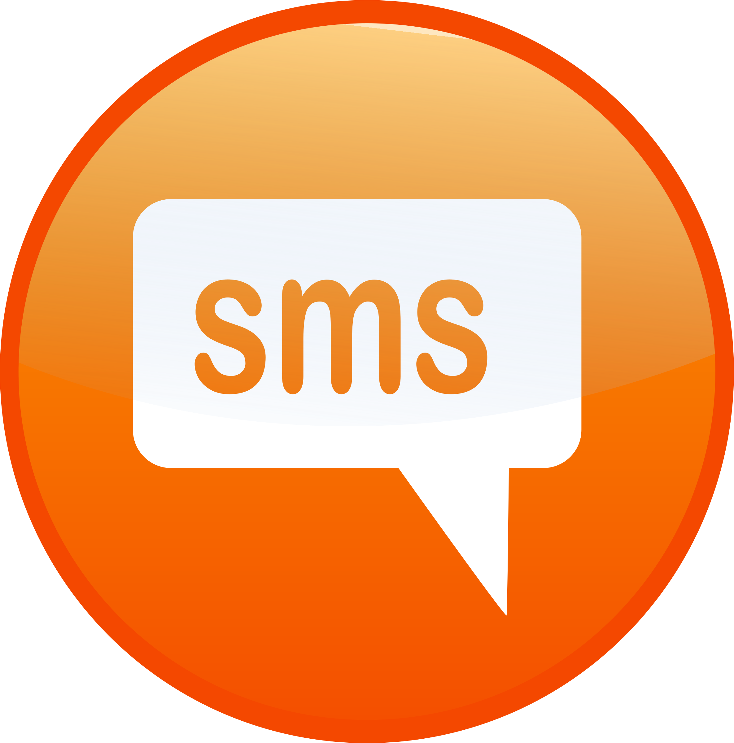
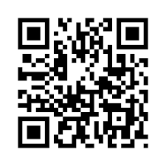

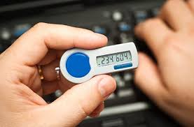
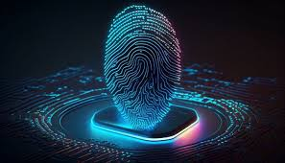
A one-time code is sent to a mobile phone or email address, which the user enters to verify their identity.
SMS/EMAIL VERIFICATION CODES
Apps like Google Authenticator generate time-sensitive one-time passwords.
AUTHENTICATION APPS
The user receives a notification on their mobile device asking them to approve or deny a login attempt.
PUSH NOTIFICATIONS:
Physical devices, like YubiKey, generate one-time codes or provide direct login via USB or NFC.
HARDWARE TOKENS
Fingerprint, facial recognition, or retina scans provide strong security by verifying physical traits unique to the user.
BIOMETRIC AUTHENTICATION

Slide 6
Benefits of MFA
Increased Security: Even if one factor (e.g., a password) is compromised, the additional layers make it significantly harder for attackers to gain access.
Reduced Risk of Data Breaches: Protects sensitive data by requiring multiple verifications, even if a user’s credentials are stolen or leaked.
Compliance: Many industries (e.g., healthcare, finance) require MFA to meet regulatory requirements such as GDPR, HIPAA, or PCI-DSS.
Prevents Phishing Attacks: Even if a user falls victim to a phishing attack and gives away their password, the attacker still can't gain access without the second factor.

Slide 7
Use Cases for MFA
Enterprise Security: Used to protect corporate accounts, cloud applications (e.g., Microsoft 365, G Suite), and sensitive internal systems from unauthorized access.
Online Banking: Financial institutions use MFA to secure login to online banking accounts, requiring both a password and a code sent to a registered phone.
Social Media Platforms: Facebook, Instagram, and other platforms offer MFA to protect user accounts from unauthorized logins.
Government and Healthcare: Protects highly sensitive data (e.g., medical records, personal identification) from unauthorized access.

Slide 8
Challenges with MFA
User Convenience: While MFA increases security, it can introduce friction, requiring users to perform extra steps to log in, which may frustrate some users.
Backup and Recovery: If users lose access to their second factor (e.g., phone or token), recovering the account can be complex, requiring additional steps and security questions.
Implementation Costs: Setting up MFA infrastructure and managing tokens, devices, or biometric scanners can add costs for organizations.

Slide 9
Conclusion
MFA is a critical security measure that protects against unauthorized access.
It combines multiple factors—what you know, what you have, and what you are—to enhance security.
While MFA offers significant security benefits, user experience and convenience must also be considered.

